Slide 1
Grocery shop billing system

Slide 2
CONTENTS
Introduction
Objectives
System Features
System Workflow
Benefits
Output

Slide 3
Introduction
A Grocery Shop Billing System is a software application designed to streamline and automate the billing process in grocery stores. It simplifies the operations of retail businesses by managing product information, calculating bills, applying discounts, handling payments, and generating receipts efficiently.
In traditional grocery stores, billing is often time-consuming and prone to human error. A digital billing system reduces these issues by providing accurate and quick calculations, real-time inventory updates, and detailed transaction records. It also enhances customer service by reducing waiting time at the counter.

Slide 4
Objectives
Build a system to manage grocery shop inventory and billing process efficiently. It will allow:
Adding and updating products in inventory
Adding items to customer's cart
Calculating total bill with discounts

Slide 5
product
1.Product: Holds product details (name, price, stock).
Attributes:
name (string): Name of the product.
price (float): Price per unit (e.g., per kg).
stock (float): Quantity available in stock (e.g., kg).
Responsibilities:
Store product details.
Update stock after sales.

Slide 6
Inventory
2.Inventory: Maintains a collection of products, supports adding and updating products.
Attributes:
A collection (e.g., dictionary) of products.
Responsibilities:
Add new products.
Update existing product stock and price.
Check stock availability.
Fetch product info.

Slide 7
BILLING
3.Bill: Keeps track of purchased products, calculates totals, and applies discounts.
Attributes:
Purchased products and their quantities.
Total price.
Responsibilities:
Add items to the bill/cart.
Calculate the total cost.
Apply discounts if any.
Generate the final bill.

Slide 8
System features
Key Features of a Grocery Shop Billing System
1.Product Management
Add new products with details such as name, price, and available stock.
Update existing product information (price, stock).
2.Inventory Management
Track current stock levels for each product.
Automatically update stock after every purchase.

Slide 9
3.Billing and Cart Management
Add selected products and quantities to a shopping cart.
Calculate the total price dynamically based on quantity and unit price.
Apply discounts to the entire bill.
4.Discount Application
Support percentage-based discounts.
Apply discounts manually based on percentage.
The discount will be applied on the total bill, and not the individual products.

Slide 10
5.Transaction Processing
Generate bills/invoices showing purchased products, quantities, prices, discounts, and total amount.
After the billing process when all the products are added to the bill and no items left, the shopkeeper clicks 'checkout', after checkout the cart and discount gets cleared for any future billings.
6.Stock Adjustment on Purchase
Reduce product stock by the quantity purchased (e.g., if customer buys 2kg of Rice, reduce stock from 20kg to 18kg)
The stock reductions will reflect on the inventory.json file, which is our inventory data.

Slide 11
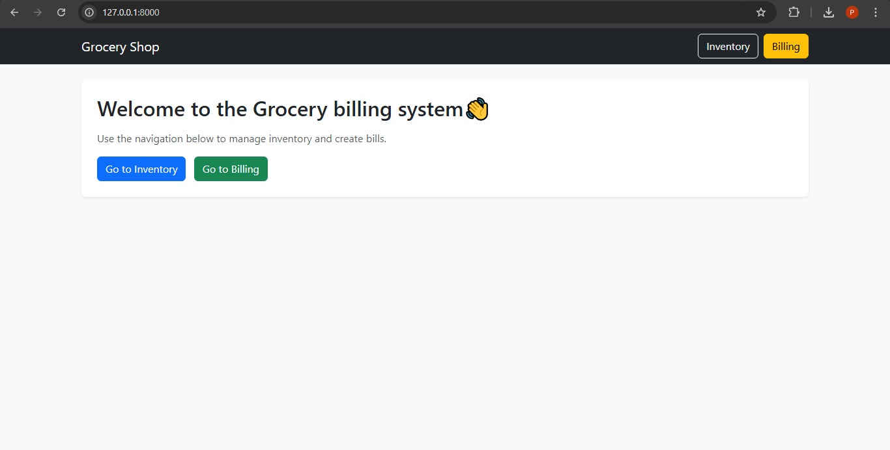
System Workflow for Grocery Shop Billing System
1.Start
User (shopkeeper or cashier) opens the system.

Slide 12
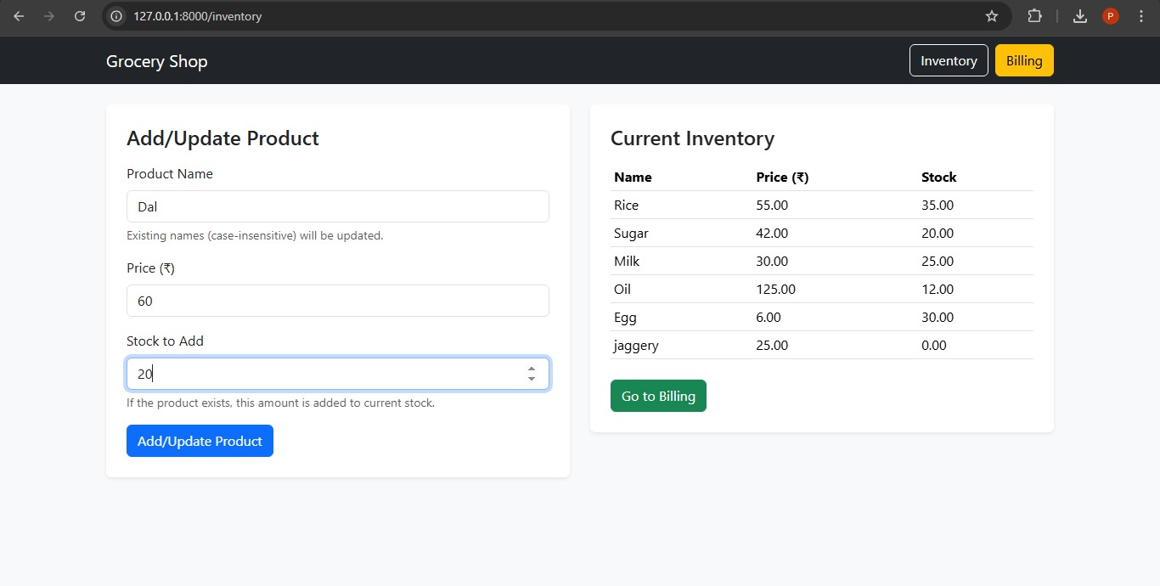
System Workflow for Grocery Shop Billing System
2.Product Management
Admin adds or updates products in inventory.
Example: Add product “Rice” with price ₹50/kg and stock 20kg.
3.Update Inventory
Deduct purchased quantity from product stock.
Example: Rice stock reduces from 20kg to 18kg.

Slide 13
System Workflow for Grocery Shop Billing System
4.Customer Purchase Begins
Customer selects items to buy.
Cashier adds products and quantities to the cart.
Example: Customer buys 2kg of Rice.

Slide 14
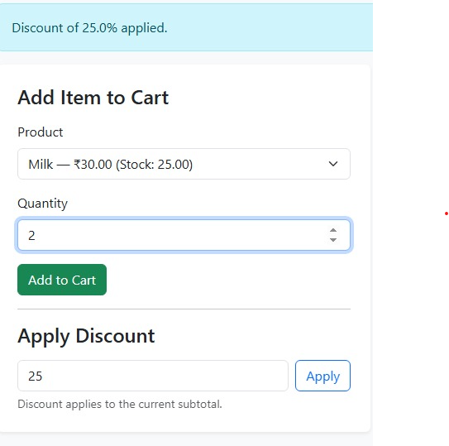
System Workflow for Grocery Shop Billing System
5.Apply Discounts (If any)
System applies any eligible discounts to the total amount.

Slide 15
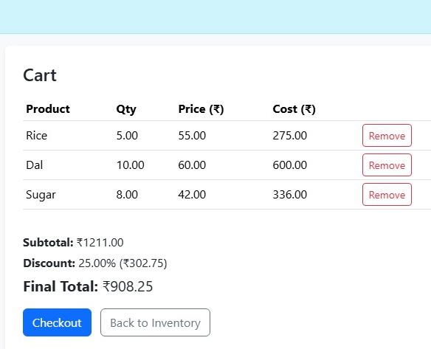
System Workflow for Grocery Shop Billing System​
6.Generate Bill
Create a bill showing purchased products, quantities, prices, discounts, and total payable amount.

Slide 16
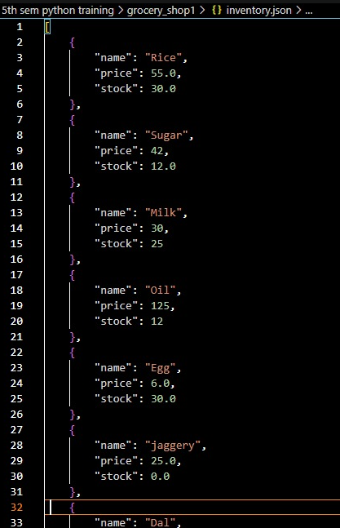
System Workflow for Grocery Shop Billing System
9.Save The inventory
Save the inventory with the reduced stock, meaning the purchased items will be deducted from the inventory and the newly added products will be stored in the inventory.
As we are using Json file to store inventory, even if the process/server ends the inventory will still be intact.

Slide 17
benefits
Accuracy in Billing
Time Efficiency
Inventory Management
Better Customer Experience
Reduced Paperwork
Cost-Effective

Slide 18
Thank You

